Slide 1
Retro Paradise
an app for the games of the past
Darin McDonald
Jacob White
Lawrence Murillo

Slide 2


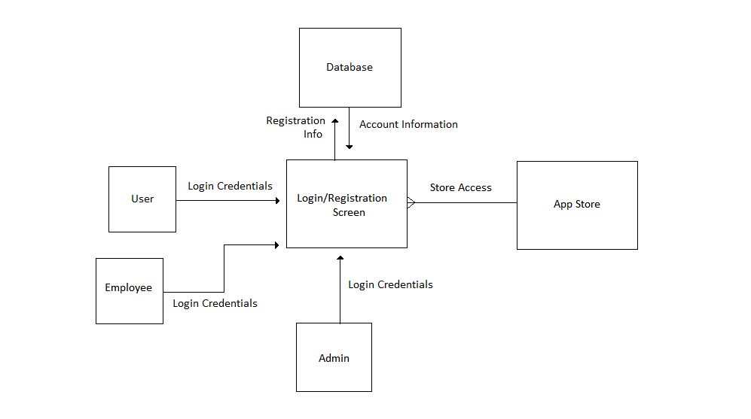
Context diagram

Slide 3
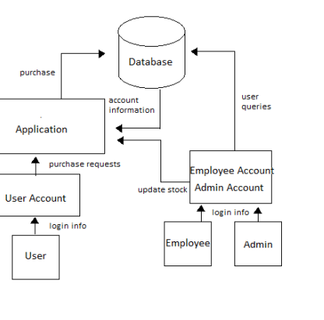
Diagram 0

Slide 4
What is retro paradise?
Retro Paradise is store that buys and sells old video game consoles and games at a fair price all at the click of a button on your smartphone.
Have you ever thought “Wow, I would really like to get this game I played when I was younger?” well we got you covered.
This app is designed to cater towards retro game fans to help bring back rare/hard to find group of video games.

Slide 5
How do I use it?
To use the app for our store you will have to register an account. It’s simple! After providing the information your account will be created and you can login and start shopping.

Slide 6
Okay I’m signed in… now what?
Now that you’ve signed in you can search for anything you want using the browse option when the homepage opens!
There are options to see newly added games and products that are coming soon.

Slide 7
Still need help with the app?
There’s a user manual for anyone that needs further assistance with using and navigating our app!

Slide 8
Technology used
MariaDB/mySql
Javafx
Netbeans IDE

Slide 9
Moving forward
With additional time and effort we hope to grow this app from what it is now to something much greater. Many more updates that allow more functionality and of course anything else we can do to make sure this app grows to be a paradise for the games of old.

Slide 10
Thank you!

